Slide 1
On-Demand Sales Insights
Consumers Goods
Created by : Dhanshree Kharat

Slide 2
Situation Analysis
AtliQ Hardware, a leading name in the computer hardware sector both in India and globally, has recognized the need to strengthen its data-driven decision-making processes.
Despite its strong market position, the company currently lacks the agility in analytics needed to support timely and strategic business decisions.
To address this, AtliQ Hardware is expanding its data analytics team by recruiting junior data analysts capable of contributing to this transformation.
As part of the hiring process, Tony Sharma, Director of Data Analytics, has designed a comprehensive SQL assessment to evaluate candidates on both technical proficiency and communication skills.
The selected analysts will be expected to deliver actionable insights by addressing 10 specific ad hoc business queries.

Slide 3
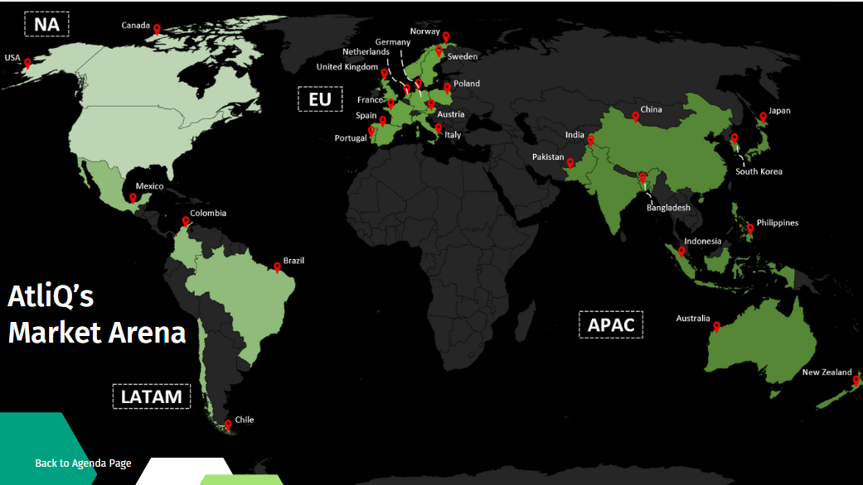

Slide 4
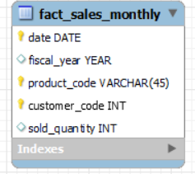
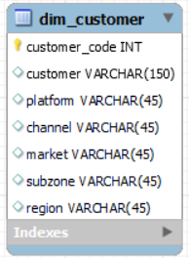
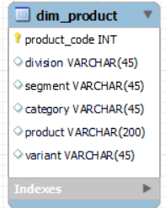
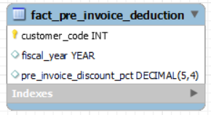
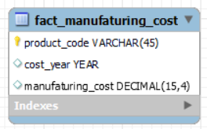
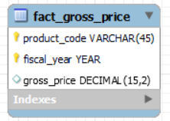
Data In Tabular Format
Fact Tables
Dimension Tables
Dimension Tables

Slide 5
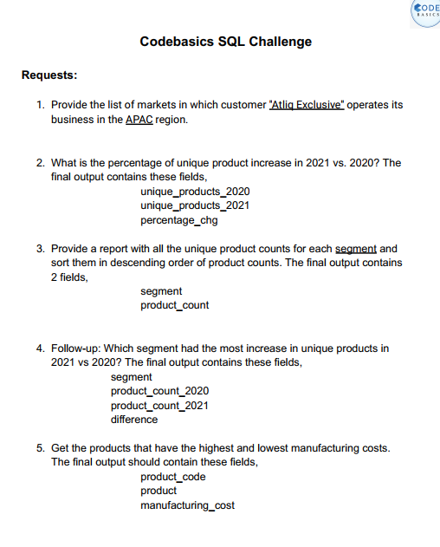
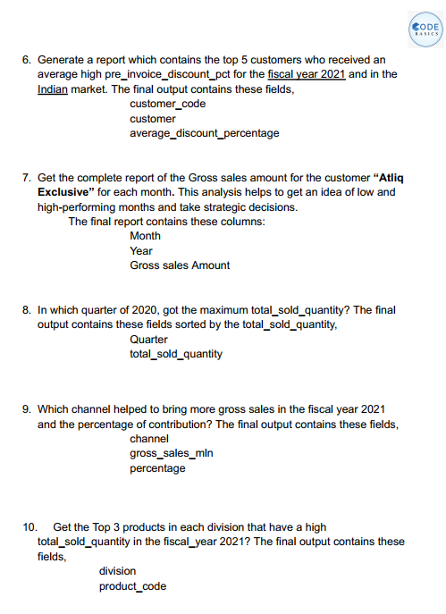
Ad-hoc Request

Slide 6
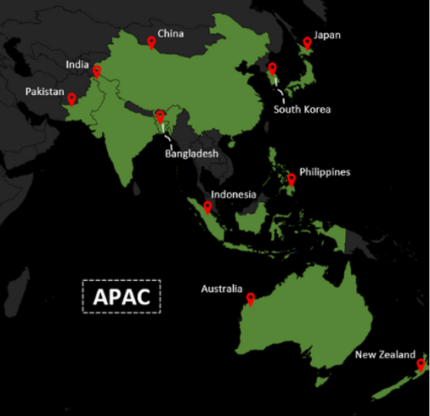
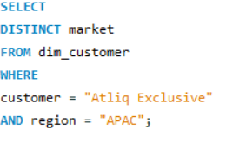
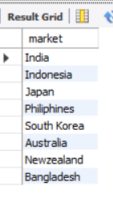
Request 1
Provide the list of markets in which customer "Atliq Exclusive" operates its business in the APAC region.
Solution :-
There is 8 key markets in APAC region , underscoring its strategic emphasis on this dynamic and rapidly growing area

Slide 7
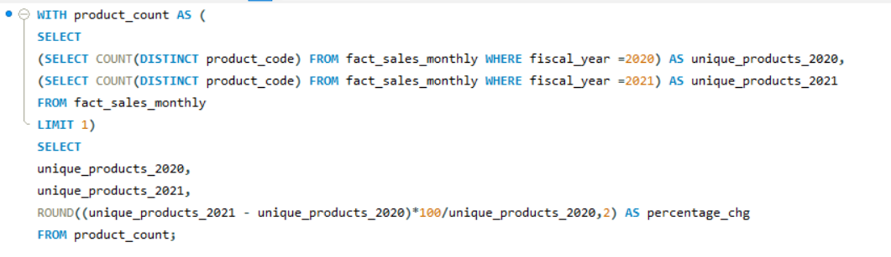

Request 2
What is the percentage of unique product increase in 2021 vs. 2020? The final output contains these fields: (unique_products_2020, unique_products_2021, percentage_chg)
Solution :-
chg % 36.33
"As shown in the graph, AtliQ Hardware demonstrates strong innovation and adaptability to market demands, ensuring a diverse and evolving product portfolio."

Slide 8
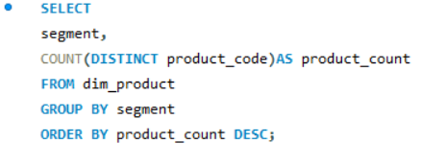
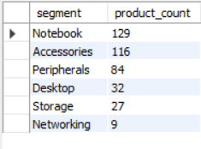
Request 3
Provide a report with all the unique product counts for each segment and sort them in descending order of product counts. The final output contains 2 fields: (segment, product_count)
Solution :-
The analysis of AtliQ Hardware’s product categories reveals a strong market presence in Notebooks (129 units) and Accessories (116 units), indicating high consumer demand and effective product positioning. Peripherals (84 units) also show solid performance, contributing to a well-rounded portfolio.
In contrast, categories like Desktop (32), Storage (27), and especially Networking (9) exhibit significantly lower sales, suggesting either limited demand or potential gaps in marketing or innovation strategies.
Overall, the data highlights AtliQ’s ability to innovate and adapt to evolving market trends through a diverse product offering. However, there is room to optimize or reposition underperforming segments to ensure balanced growth across the portfolio.

Slide 9
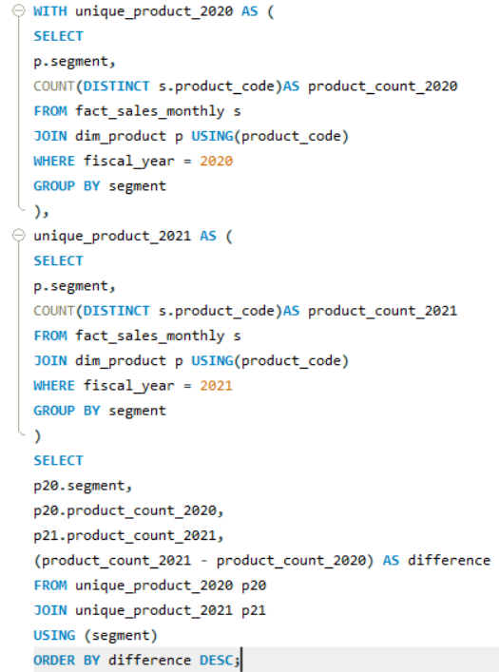
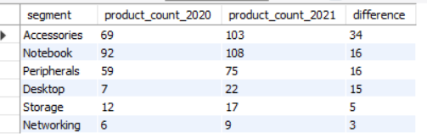
Request 4
Follow-up: Which segment had the most increase in unique products in 2021 vs 2020? The final output contains these fields: (segment, product_count_2020, product_count_2021, difference)
The comparison between 2020 and 2021 product counts shows consistent growth across all categories, with the most significant increases seen in Accessories (34 units) and Notebooks (16 units). Peripherals and Desktop also experienced notable gains, reflecting AtliQ Hardware's proactive approach to expanding its product range.
This upward trend highlights the company’s commitment to innovation and responsiveness to market demands, strengthening its competitive edge.

Slide 10
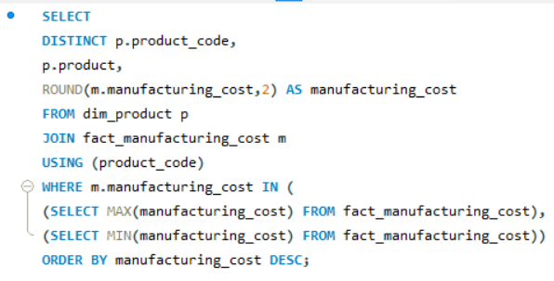

Request 5
Get the products that have the highest and lowest manufacturing costs. The final output should contain these fields: (product_code, product, manufacturing_cost)
The manufacturing cost data reveals a stark contrast between the two products.
The AQ HOME Allin1 Gen 2 incurs a significantly higher manufacturing cost of $263.42, suggesting that it is a complex, high-end product possibly equipped with advanced features or components. On the other hand, the AQ Master wired x1 Ms has a much lower manufacturing cost of only $0.87, indicating that it is likely a simple, low-cost item.
This variation in cost highlights the need for differentiated pricing strategies and margin analysis based on product complexity. Understanding these differences is crucial for effective cost management, product positioning, and strategic decision-making within the company.

Slide 11
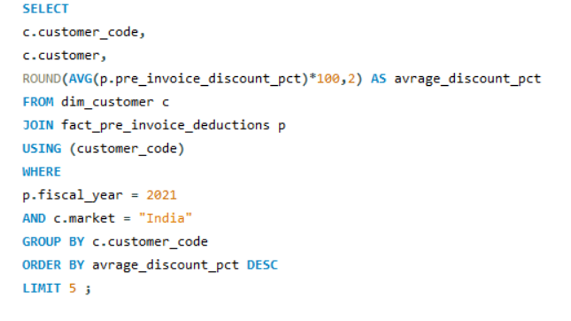
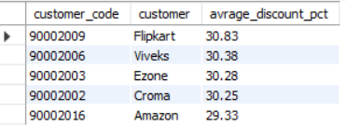
Request 6
Generate a report which contains the top 5 customers who received an average high pre_invoice_discount_pct for the fiscal year 2021 and in the Indian market.
The final output contains these fields: (customer_code, customer, average_discount_percentage).
The bar chart illustrates the contribution of different product categories to total revenue, with only slight variation among them. The Laptop category leads with a 31% share, closely followed by Smartphones, Accessories, and Tablets, each contributing 30%. Televisions contribute the least at 29%.
This distribution indicates a relatively balanced revenue contribution across all categories, suggesting that AtliQ Hardware maintains a well-diversified product portfolio.However, the slightly higher share from laptops may point to stronger market demand or better profit margins in that segment

Slide 12
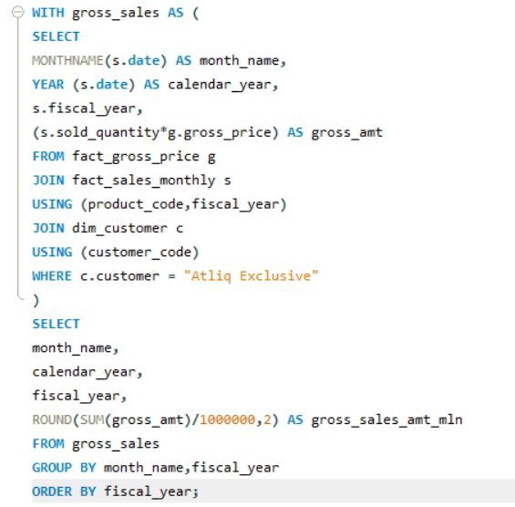
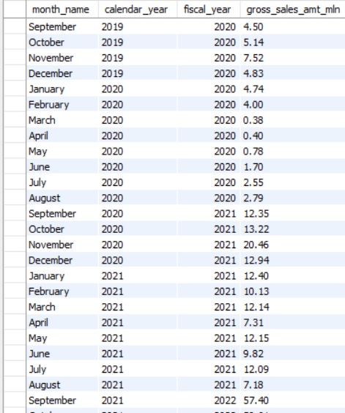
Request 7
Get the complete report of the Gross sales amount for the customer “Atliq Exclusive” for each month . This analysis helps to get an idea of low and high-performing months and take strategic decisions.
The final report contains these columns: (Month, Year, Gross sales Amount).

Slide 13
2019
2020
2021
In November 2021, Atliq Exclusive achieved its highest gross sales, reaching 20.46million, indicating a strong recovery and spike in demand after the initial COVID-19 disruptions. In contrast, March 2020 marked the lowest point, with sales dropping to just 0.38 million, largely due to the pandemic and nationwide lockdowns.
The data reveals a sharp sales decline between February and April 2020, followed by a steady rebound beginning in May. Strong sales performance from September 2020 to January 2021, along with another significant rise in May 2021 to 12.15 million, highlight the company’s effective recovery efforts and market resilience.
These fluctuations in sales serve as valuable insights for identifying critical periods of vulnerability and recognizing areas for strategic growth and planning

Slide 14
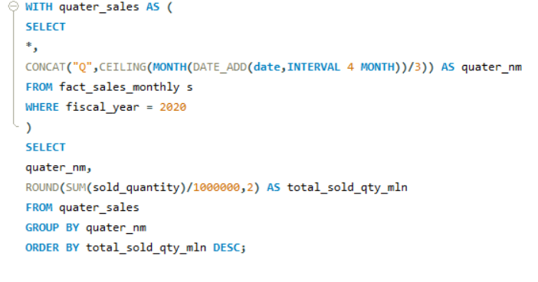
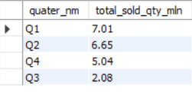
Request 8
In which quarter of 2020, got the maximum total_sold_quantity? The final output contains these fields sorted by the total_sold_quantity, (Quarter, total_sold_quantity).
In FY 2020, Quarter 1 (Sept–Nov) saw the highest sales at 7.01 million units. Sales dropped sharply in Quarter 3 (Mar–May) to 2.08 million units, the year's lowest, due to the pandemic. Quarter 2 (Dec–Feb) recorded a strong 6.65 million units sold. Quarter 4 (Jun–Aug) followed with 5.04 million units, showing signs of recovery. The impact of COVID-19 clearly disrupted sales patterns. Seasonality and pandemic effects played key roles in shaping annual sales trends.

Slide 15
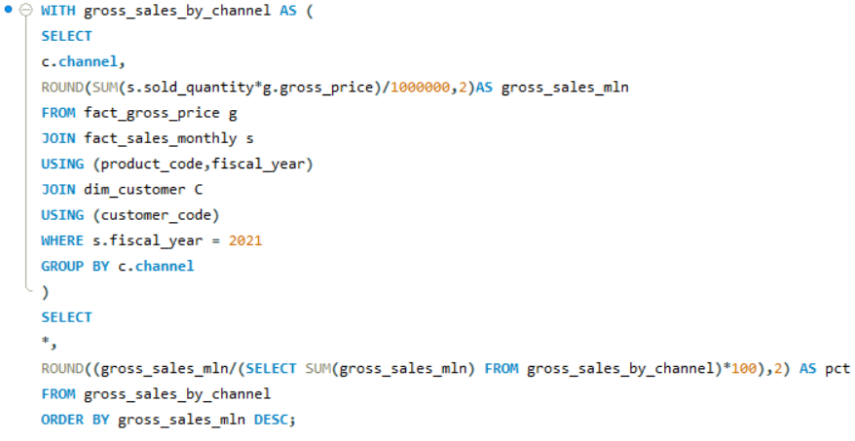
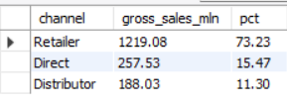
Request 9
Which channel helped to bring more gross sales in the fiscal year 2021 and the percentage of contribution?
The final output contains these fields: (channel, gross_sales_mln, percentage).
188.03
Distributer
257.53
Direct
Retailer
1219.08
In fiscal year 2021, the Retailer channel emerged as the leading contributor to AtliQ Hardware’s gross sales, generating 73.23% of total revenue, which amounted to 1219.08 million. This significant share highlights the vital role retailers play in the company’s distribution strategy.
In comparison, the Direct channel contributed 15.47% with 257.53 million, while the Distributor channel had the lowest contribution at 11.30%, totaling 188.03 million.
These figures emphasize the need to continue strengthening the retail channel while also identifying opportunities to improve sales performance and efficiency within the direct and distributor segments.

Slide 16
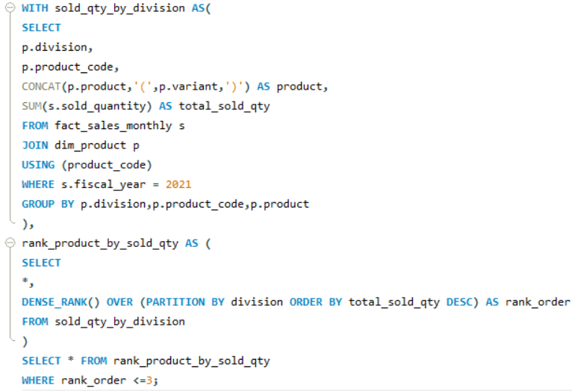
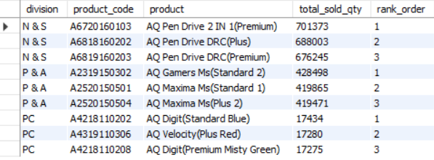
Request 10
Get the Top 3 products in each division that have a high total_sold_quantity in the fiscal_year 2021?
The final output contains these fields: (division, product_code, product, total_sold_quantity, rank_order)

Slide 17
The N & S division sees strong performance from pen drives, reflecting high market demand for storage devices. Meanwhile, the P & A division is led by gaming and high-efficiency mouse products, indicating growing consumer interest in performance-oriented peripherals. In contrast, the PC division is experiencing lower sales volumes and could potentially improve its market position through focused marketing strategies and enhanced product development efforts.

Slide 18
Project Outcome
AtliQ Hardware has been steadily expanding its market reach, particularly in the APAC region, thanks to strong product performance. In 2021, the company introduced 102 new products, with a focus on notebooks, accessories, and peripherals, reflecting its dedication to innovation and segment growth. These three categories make up 82.87% of the product range. However, there’s room to grow in weaker areas like desktops, storage, and networking, especially in low-margin regions.
Analysis of manufacturing costs revealed inconsistencies, indicating potential for better cost control. By streamlining production in low-performing areas, AtliQ can enhance pricing strategies and increase profitability. In terms of sales, Amazon in India led in revenue despite offering smaller discounts, compared to Flipkart, which had higher discounts. This suggests that finding the right balance in discounting is key for maximizing both volume and margins.
Retail channels played a significant role, contributing 75% of total sales in FY 2021. Though Direct sales had a lower share, they performed well in terms of average order value. Strategic alignment with high-performing months like November 2020 can help boost results across all sales channels.

Slide 19
Recommendation
To improve overall profitability, AtliQ should focus on boosting sales in underperforming categories like desktops, storage, and networking, especially in emerging markets. It should also expand premium product offerings in accessories, notebooks, and peripherals, particularly where demand is high, like in the APAC region.
Fine-tuning discount strategies is essential—moderate discounts, as seen with Amazon in India, can drive high revenue. Strengthening ties with retail partners and expanding into e-commerce can further enhance sales performance. Lastly, leveraging insights from peak periods such as November will help in planning inventory, marketing, and promotions more effectively, aligning them with consumer behavior and demand trends.

Slide 20


